Slide 1
Real2Sim: Creating Real Environments That Act Like Sims

Slide 2
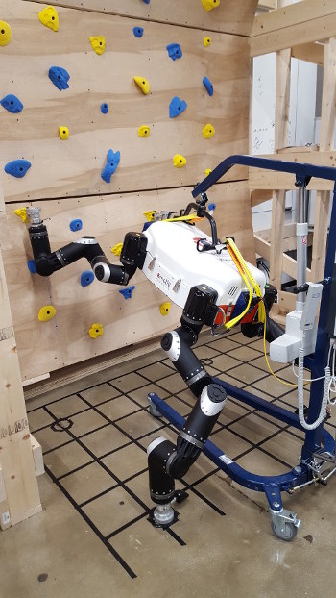
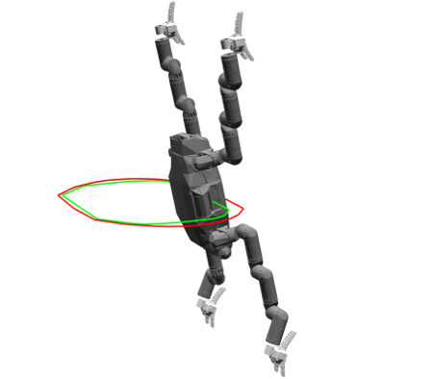
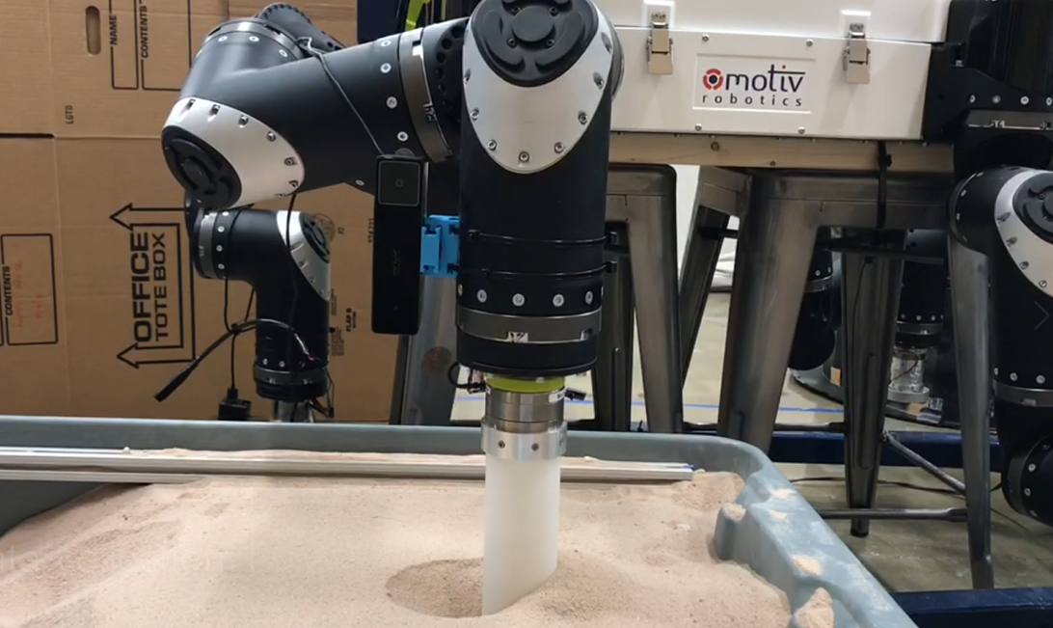
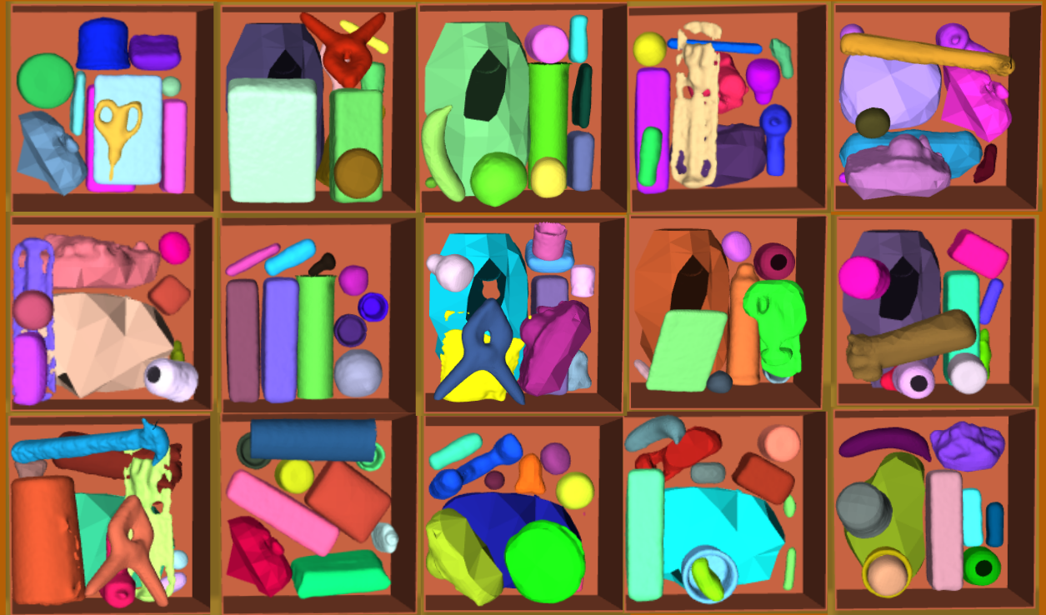
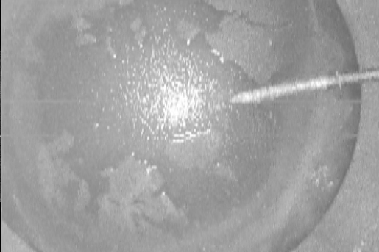
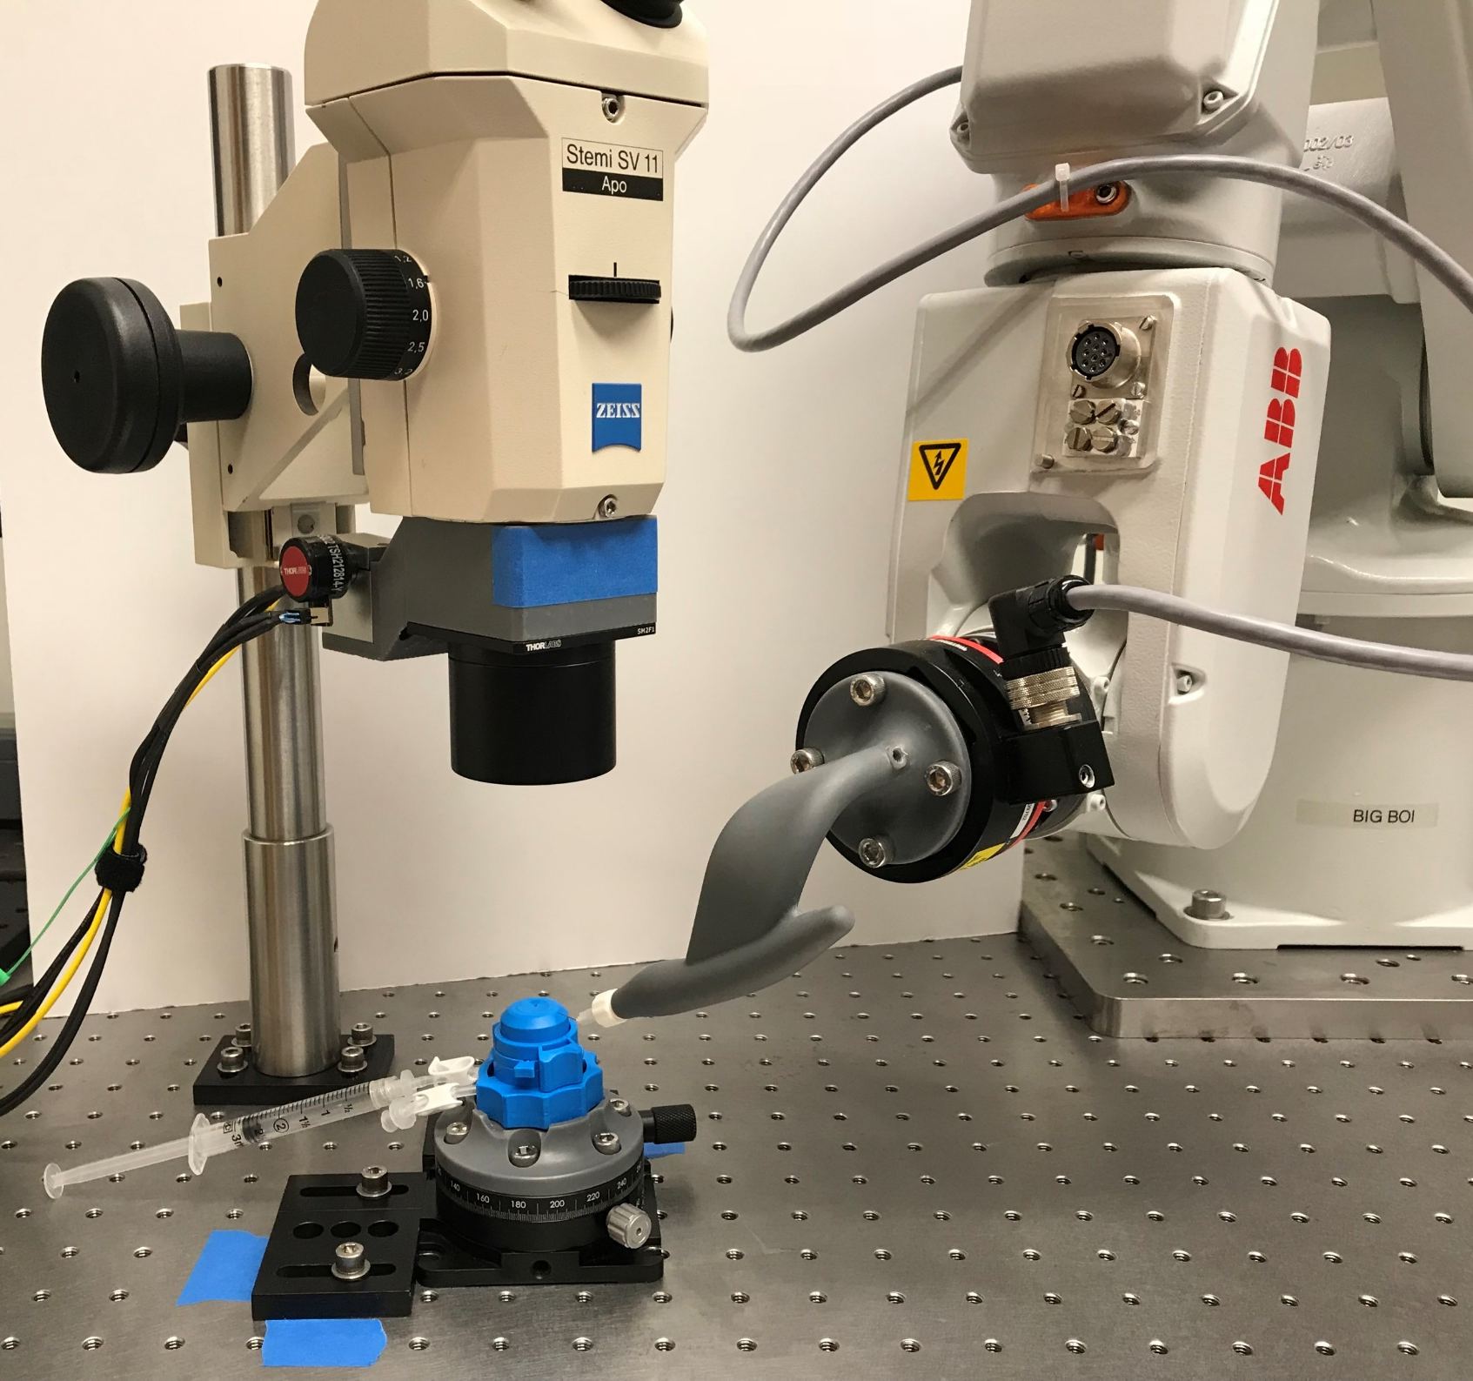
Real2Sim: Generalizable Learning to Simulate Complex Contact Phenomena
Kris Hauser

Slide 3
Simulation testing of autonomous vehicles

Slide 4
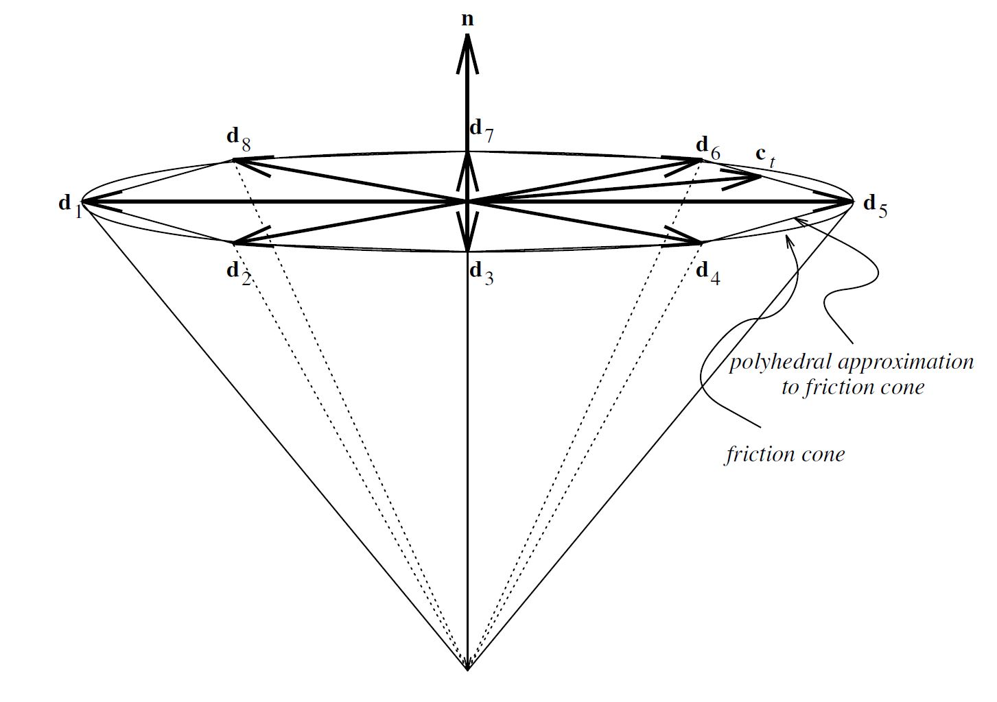
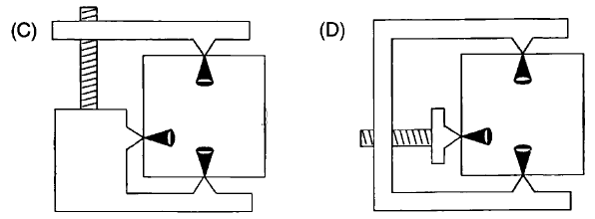
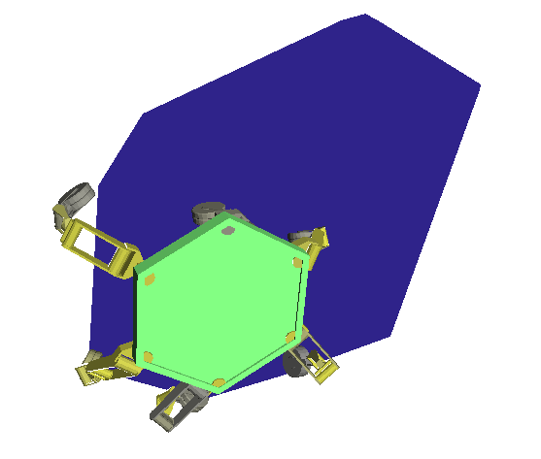
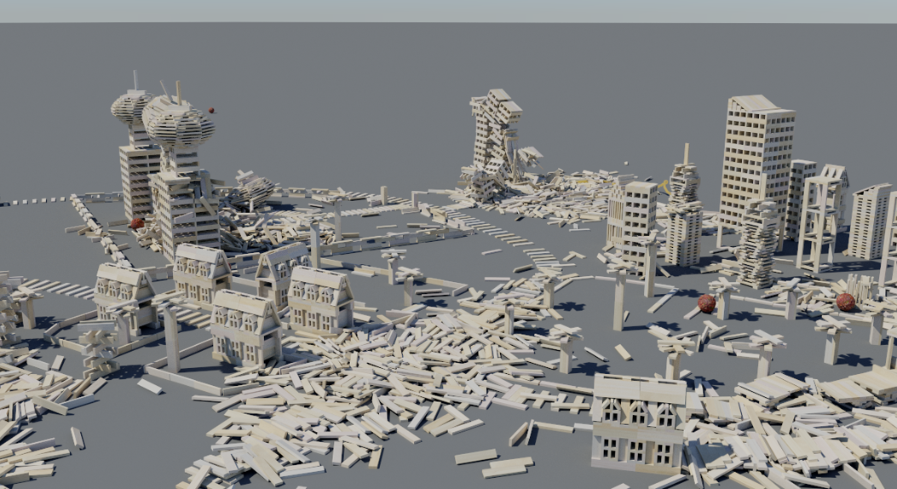
Analytical contact models are very useful
(Stewart,2000)
Force closure but not form closure
Not force closure
Support polygon (top)

Slide 5
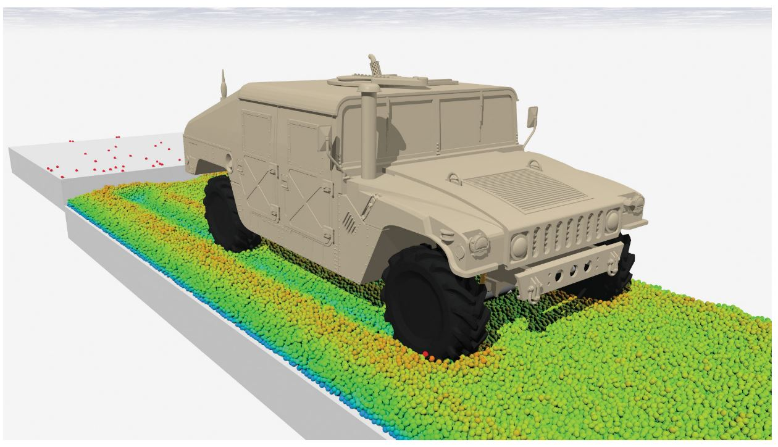
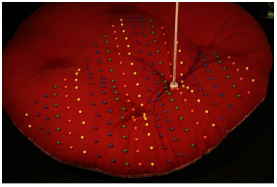
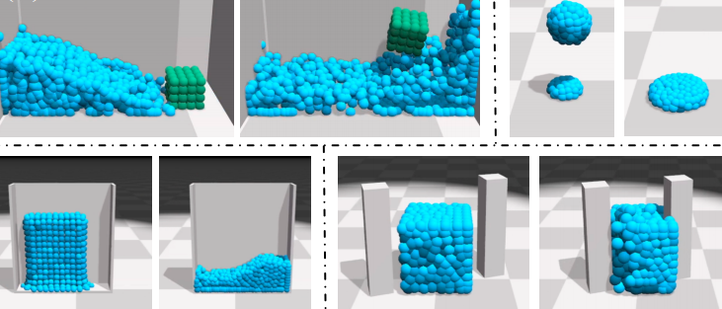
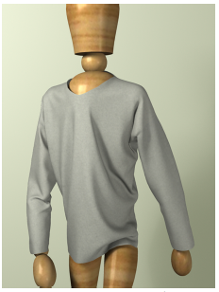
Simulating complex phenomena
(Tasora,2015)
(Bickle,2009)
(Li,2018)
(Wang,2011)

Slide 6
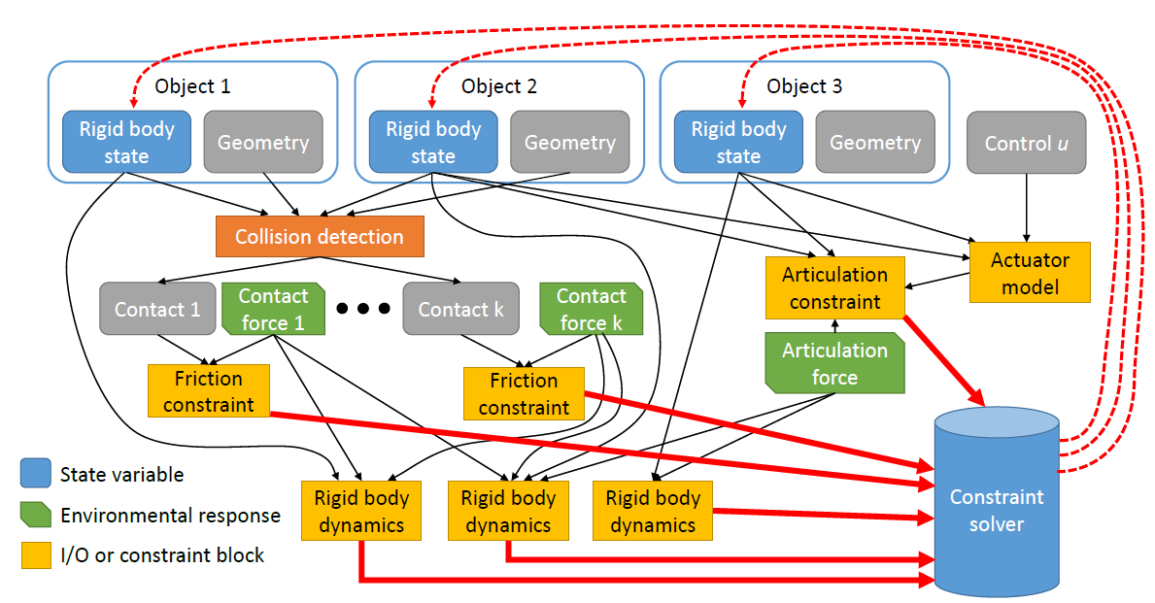
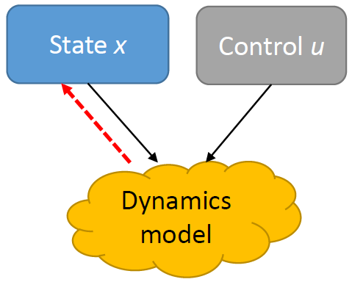
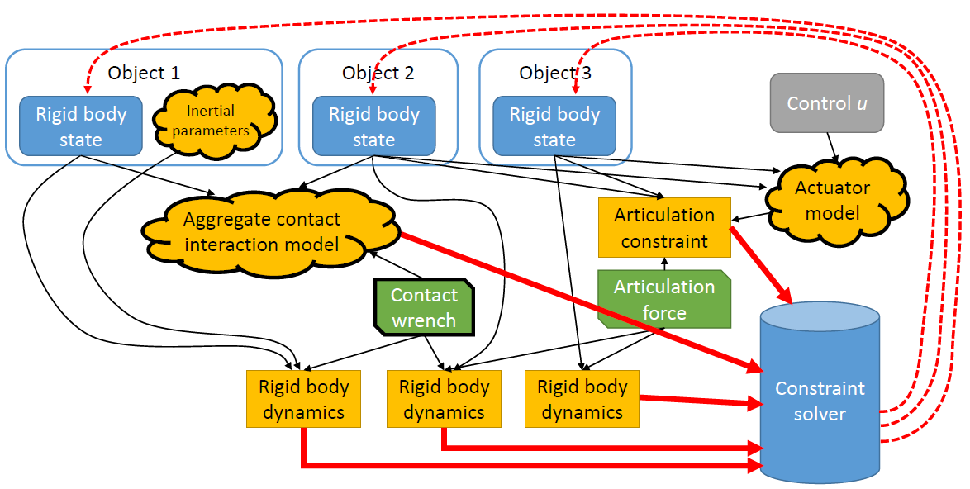
Analytical
Empirical
Real2Sim

Slide 7
3D scanned objects in simulation
[Hauser, Robust Contact Generation for Robot Simulation with Unstructured Meshes, ISRR 2013]

Slide 8
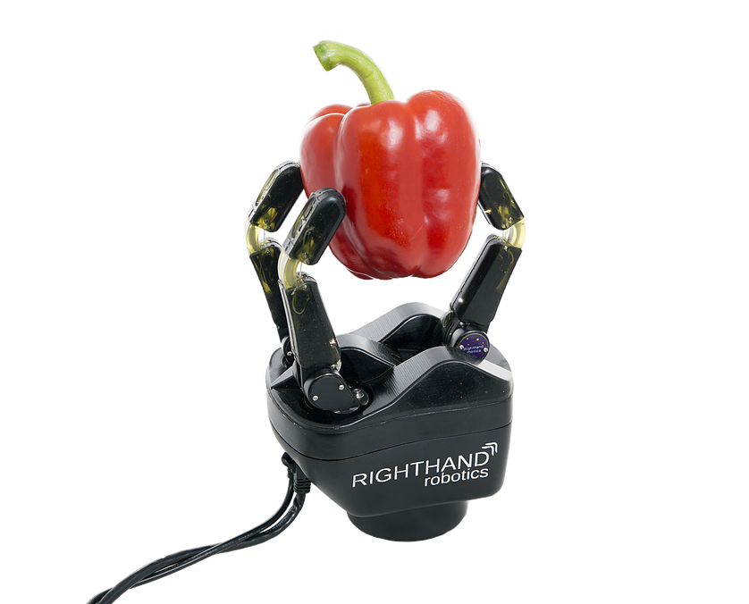
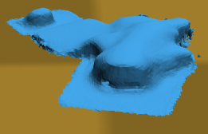
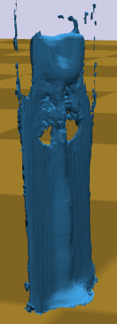
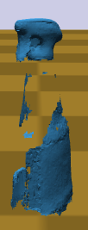
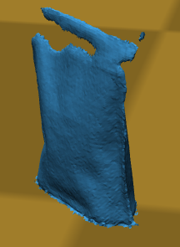
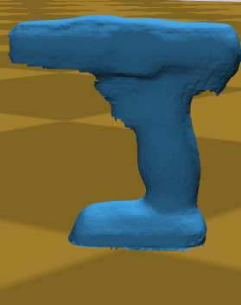
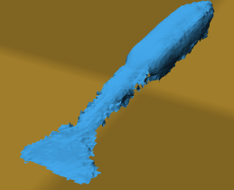
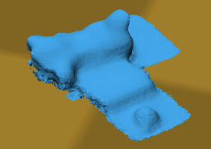
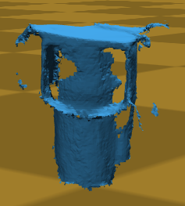
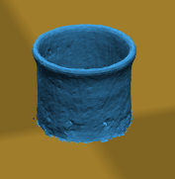
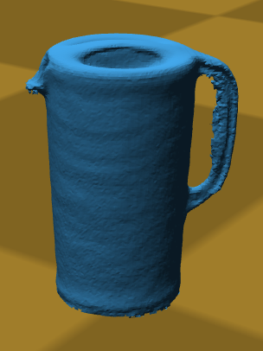
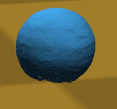
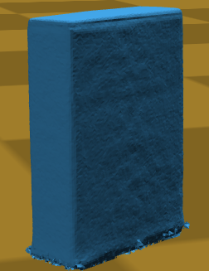
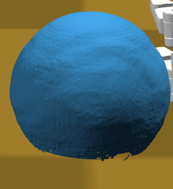
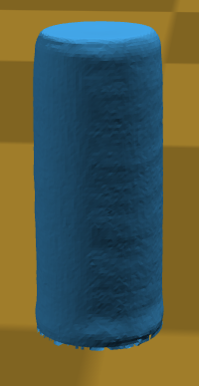
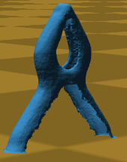
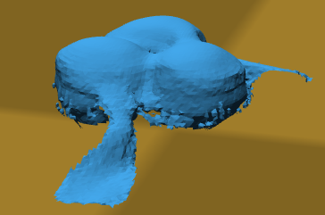
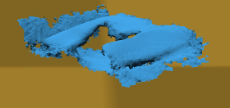
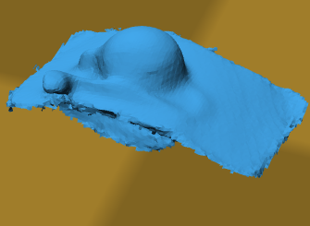
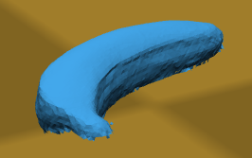
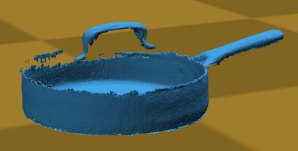
Stress testing
IROS 2016 Robot Grasping and Manipulation Challenge simulation track
YCB Object Set (above), APC 2015 dataset, Princeton Shape Benchmark

Slide 9
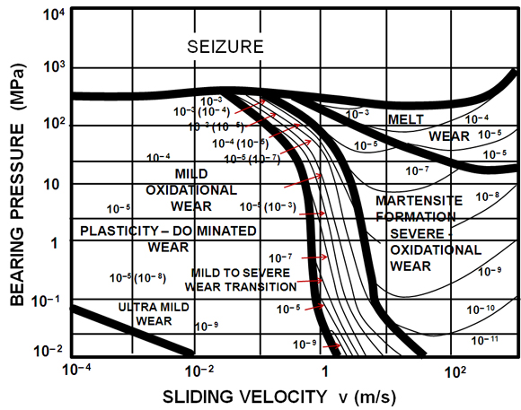
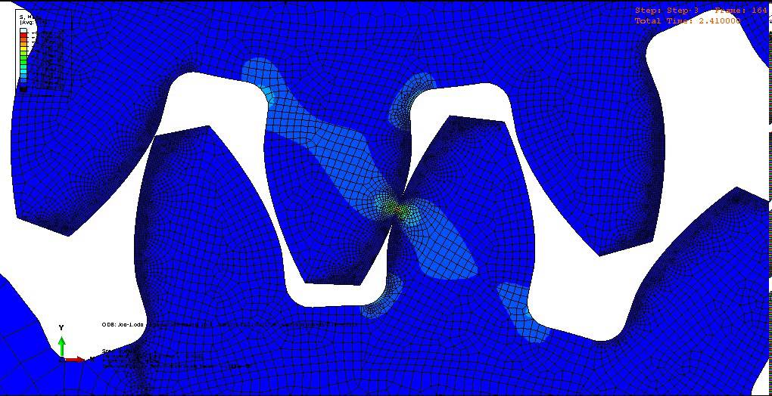
Contact mechanics is not just Coulomb models

Slide 10
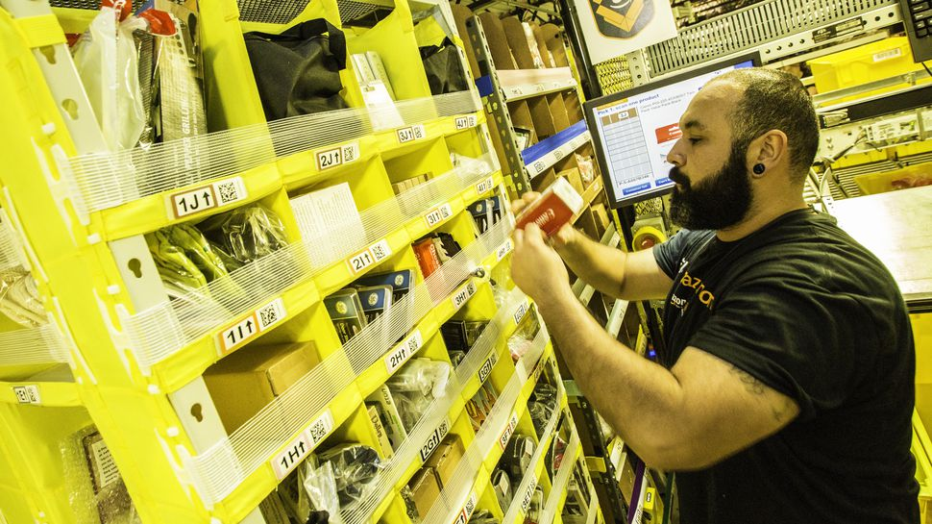
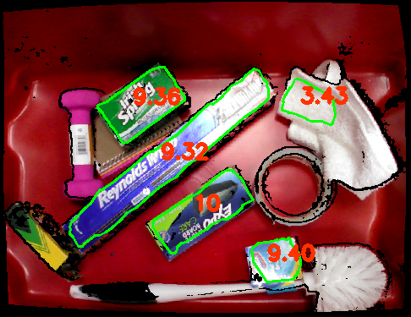
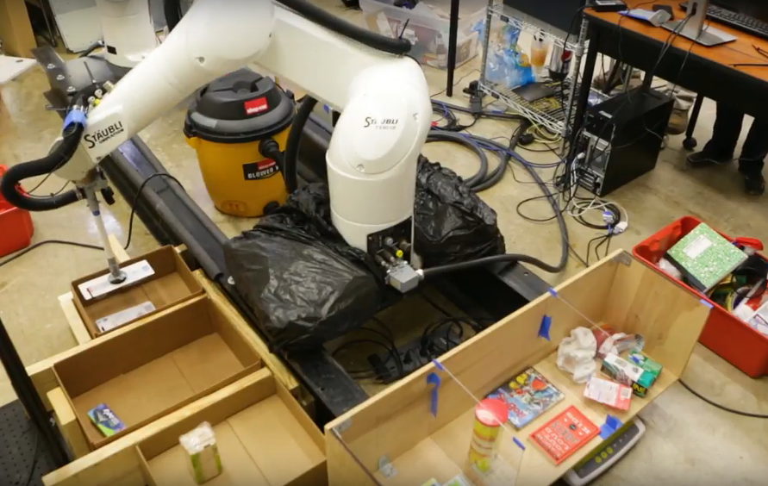
Amazon Picking Challenge
Aerodynamics of a vacuum gripper
Articulation, pages
Deformation
Bristles, nonuniform friction
(Plastic packaging, flexing, …)

Slide 11
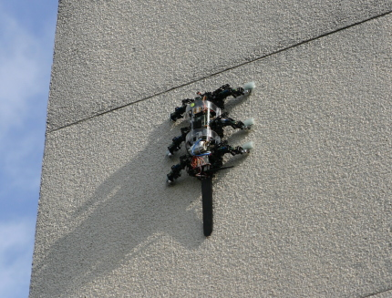
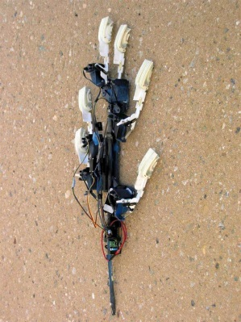
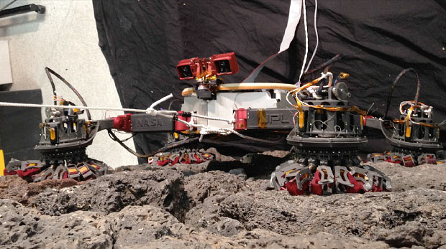
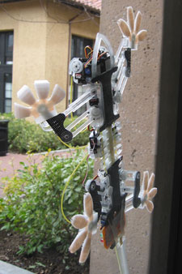
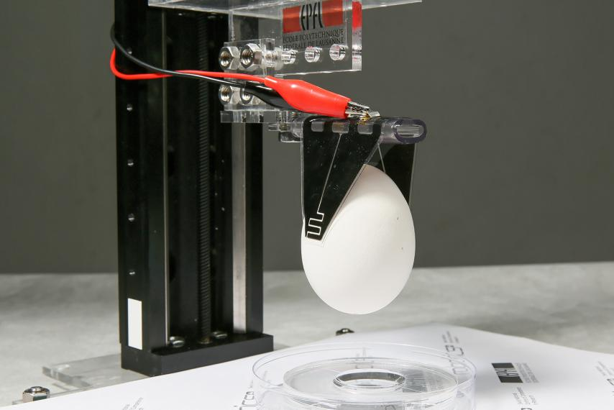
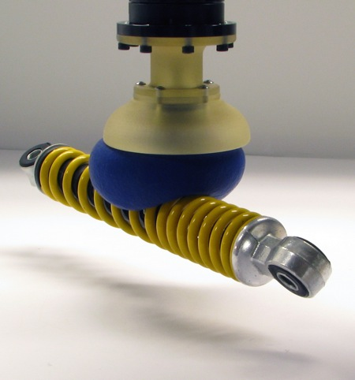
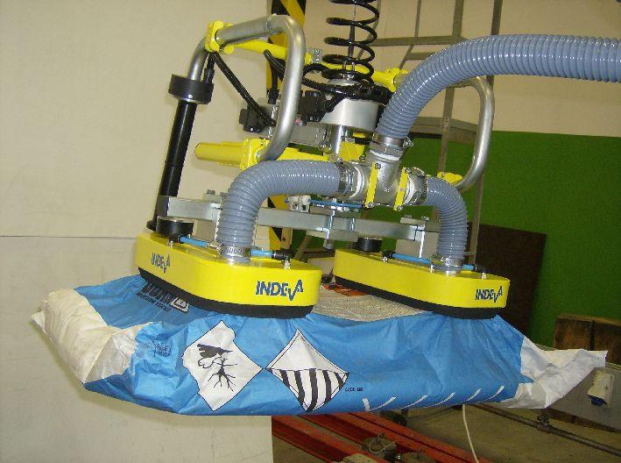
Exotic grippers
Adhesion / anisotropic forces useful for locomotion, manipulation
Suction
Electrostatic
Spines
Van der Waals
Granular jamming
RiSE
Spinybot
LEMURIIb
Stickybot
CMU/MPI
EPFL
Cornell/Chicago

Slide 13
Microspine hands for vertical climbing
Microspine unit: spring loaded needles latch onto asperities in rock
Large “downward” shear, adhesion per unit
Unit
Palm
Hand
Parallel (sloper)
Crimp
Can we predict which grasps to use?
Which Robosimian poses to use?
[Hauser, Wang, Cutkosky, RSS 2017, TRO 2018]
Opposing
Pinch

Slide 14
Sloper
Crimp

Slide 15
Admissible force volume modeling
Define contact patch and local frame
Measure max forces in all directions to obtain admissible volume
Stochastic single-needle aggregation model agrees well with experimental data
Shear adhesion
Large shear in +x axis
Lateral shear adhesion

Slide 16
Admissible force volume modeling
Perform convex decomposition of admissible volume
If force is in region j, then $A_{j}f≤b_{j}$ is satisfied for $A_{j},$ $b_{j}$ defined by halfplanes
Feasible force iff $\left(A_{1}f≤b_{1}\right)∨…∨\left(A_{c}f≤b_{c}\right)$
Convex decomposition

Slide 17
MILP equilibrium testing
Given k contact patch reference frames and external load $w_{ext}$
Formulate wrench matrix $W$ to respect Newton-Euler equations (F/T balance, joint constraints)
Define Boolean indicators $z_{i,j}$ for each region in convex decomposition
Find $f,z_{1,1}…z_{k,c}$ such that
$$Wf+w_{ext}=0$$
$A_{i,j}f_{i}≤b_{i,j}+BIG\left(1−z_{i,j}\right)$ for $i=1,…,n$ and $j=1,…,c$
$z_{i,j}∈\{0,1\}$ for all $i,j$
$\sum_{j=1}^{c}{z_{i,j}}=1$ for all $i$
Bounding volume hierarchy + custom BnB solver heuristics: ~20-600ms for 8-48 CPs, orders of magnitude faster than SCIP, Gurobi
Load
MILP
$$F_{i,1}$$
$$F_{i,2}$$
$$H_{i}$$

Slide 18
Validation on physical passive 2-finger gripper
Wrench space calculations on SpinyHand
Power grasp
Good agreement between predictions and experiments (11/14 slip events < $5^{∘}$)
Some correctly predicted slip events
Parallel grasp
Three incorrectly predicted slip events
FP
FN
FN

Slide 19
Hierarchical semi-empirical equilibrium prediction
Robot
At each level, micro-structure force response is modeled for macro-level predictions
Compute wrist-relative wrench spaces for each grasp configuration
V-rep: inner approximation
H-rep: outer approximation
Calculate support polygon for robot at a given stance
~10s for 32 convex program solves
Gripper₁
Gripper₄
Unit₁
Unit₂₄
Spine₁
Spine₆₀
Power
Parallel
Pinch
Opposing

Slide 20
Granular Media Interaction
[Y. Zhu and K. Hauser, ICRA 2019]
Learn the force response for a single foot in order to predict novel behavior
Measurement apparatus
Wrenches measured at 720 depths, angles, and motion directions

Slide 21
Physics Simulation with Learned Wrench Spaces
For each body, calculate depth d, angle $φ$ relative to granular substrate
Use the learned model + coordinate frames to produce an H-rep of the feasible wrench space $Aw≤b$
Maximum Dissipation Principle (MDP) simulation
Global frame
Substrate
frame

Slide 22
2D simulations
Four feet connected to body with a PID controller, sand substrate
Sliding front feet forward
On slope
Trot gait

Slide 23
Learning Deformation from Force and Vision
Fused testing object point cloud
X5
Uniformly sampled surface points to be poked, with estimated normal
Starting 10mm away from the surface, poking in the normal direction until a preset force threshold while recording force-displacement data
Collecting point clouds from a few angles

Slide 24
Learning Overview
Input features: normal displacement +
P: position information only
PC: position + color
PCG: position + color + curvature
All scaled to be between 0 and 1
4 probed locations vs 20 probed locations

Slide 25
Preliminary Learning Results
Gaussian Process Regression (GPR) with optimized hyperparameters
k-Nearest Neighbors (kNN), k=5
P:position C:color G:geometry

Slide 26
Multi-point deformation model
Given single-point indentation function $β\left(x;x^{′},d\right)$
$β\left(x^{′};x^{′},d\right)=d$
Decay $β\left(x;x^{′},d\right)→0$ as x gets farther from x’
Linearity $β\left(x;x^{′},d\right)=dβ\left(x;x^{′},1\right)$ assumed, e.g. Boussinesq-Cerruti
What happens at contact patch C?
Assuming superposition of deformations, can solve for “point deformations” $\tilde{d}(x)$ at all contact points so that deformations $d(x)$ are obtained
$Β\tilde{d}=d$ with $Β$ the compliance matrix over all $x∈C$
$\tilde{d}=Βd$
Ultimate force is $\int_{x∈C}{f\left(x,\tilde{d}\left(x\right)\right)dx}$ and wrench $\int_{x∈C}{x×f\left(x,\tilde{d}\left(x\right)\right)dx}$
Solve force/displacement equality constraint

Slide 27
Recap
Generalization + fidelity in simulation by combining analytical physics, empirical data, and sensor observations
Rigid body simulation with sensed 3D objects
Non-coulomb contact
Granular media simulation
Preliminary results on deformable objects
Open questions
Learning sims from naturalistic interaction
Real2Sim2Real

Slide 28
Thanks!
Collaborators
Stanford: Mark Cutkosky, Shiquan Wang
IIT: Alessio Rocchi
Duke: Yifan Zhu*
Funding
NSF NRI #1527826
http://motion.pratt.duke.edu
DRC Track A

